Slide 1
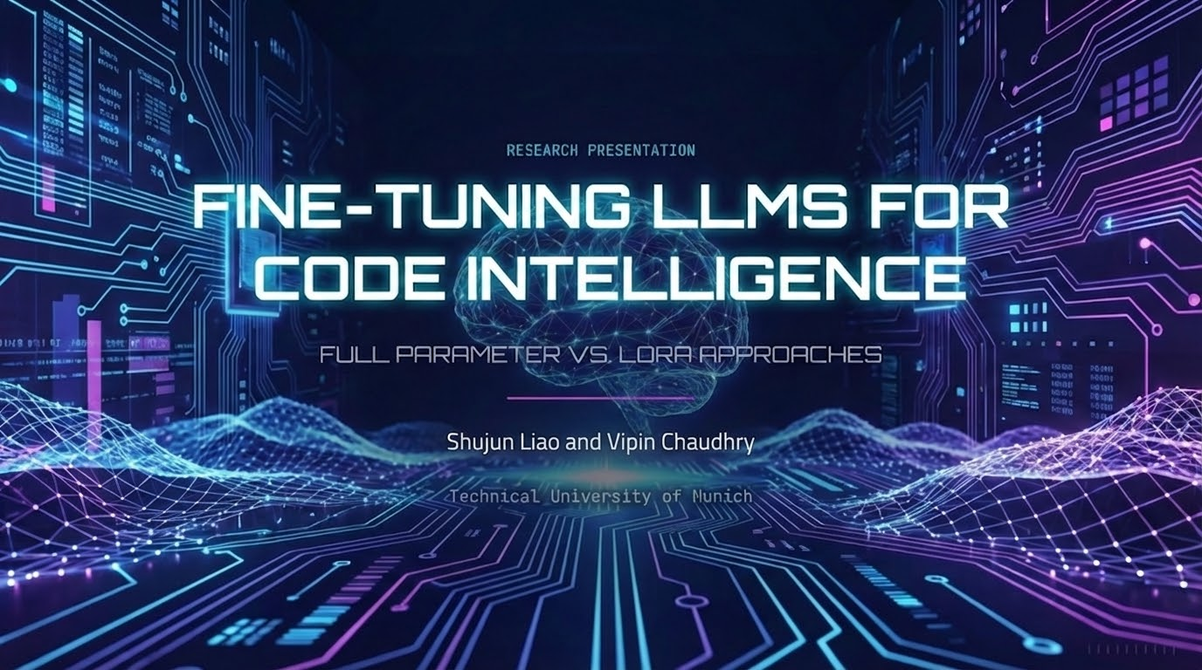

Slide 2

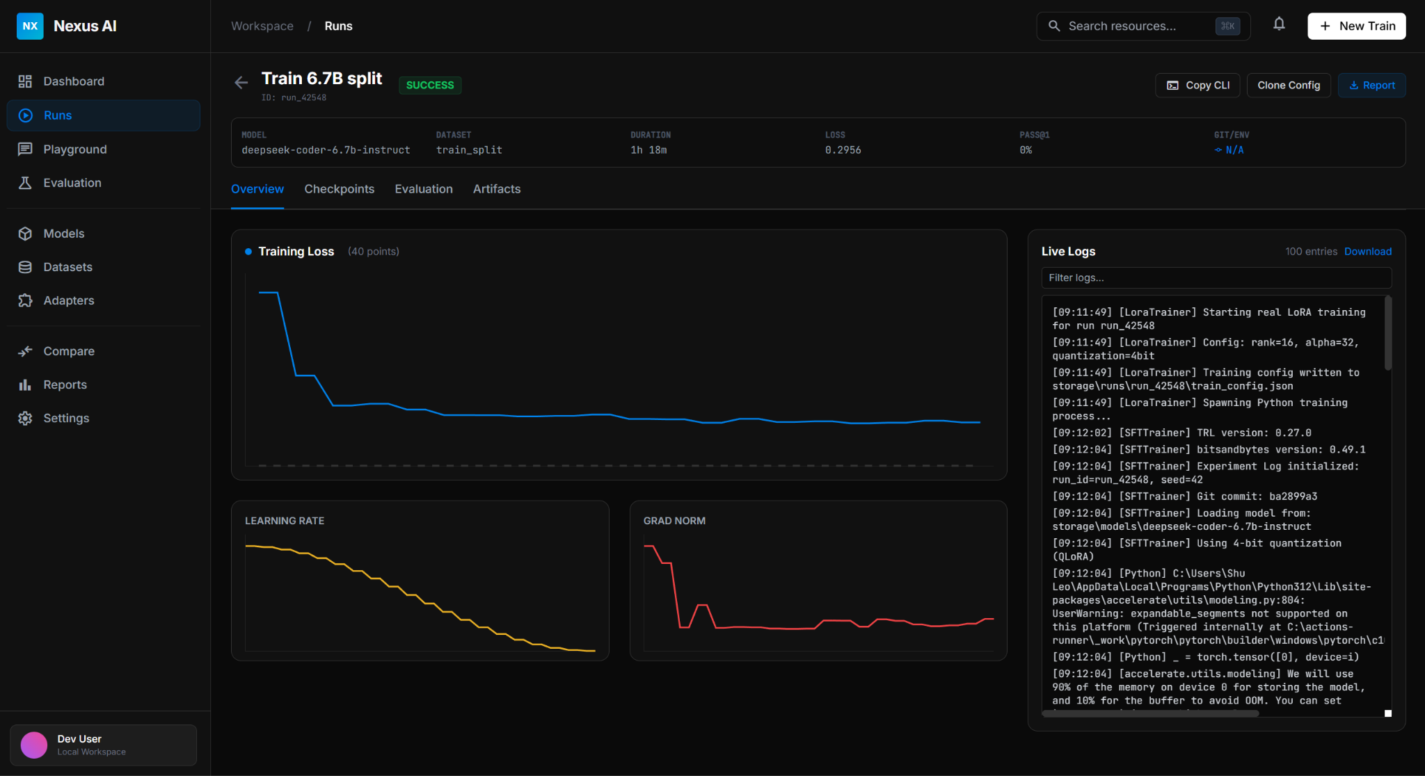
THE NEW ERA OF SOFTWARE ENGINEERING
Large Language Models (LLMs) are revolutionizing software development by automating complex tasks.
>
Code Translation: Migrating legacy systems (e.g., Java to C#) is traditionally manual and error-prone. Automation saves millions in modernization costs.
>
Code Generation: Synthesizing functional code from natural language descriptions democratizes development and accelerates prototyping.
GOAL: Evaluate fine-tuning strategies to optimize these tasks.

Slide 3



METHODOLOGY: THE COMPARISON
FULL PARAMETER FINE-TUNING
LORA (LOW-RANK ADAPTATION)
Updates 100% of model parameters.
Updates only 1-2% of parameters.
>
Requires massive computational resources.
>
Typically yields best performance for specific tasks.
>
Efficient: Runs on consumer GPUs (RTX 4070).
>
Used for: Code Translation (Java → C#).
>
Freezes pre-trained weights, injects low-rank matrices.
>
Model: CodeT5 (222M params).
>
Used for: Code Generation (Text → Python).

Slide 4






TASK 1: CODE TRANSLATION SETUP
Objective: Translate Java legacy code into modern C# using a full fine-tuning approach.
DATASET
MODEL
TRAINING
XLCOST Benchmark
CodeT5 (Base)
Full Fine-tuning
9,228 aligned parallel program pairs (Java ↔ C#). Rigorously de-duplicated.
222.88 Million Parameters. Encoder-Decoder architecture optimized for code.
3 Epochs, FP16 Precision. Trained on RTX 4070 Laptop GPU (~5 hours).
Task 1: Translation

Slide 5
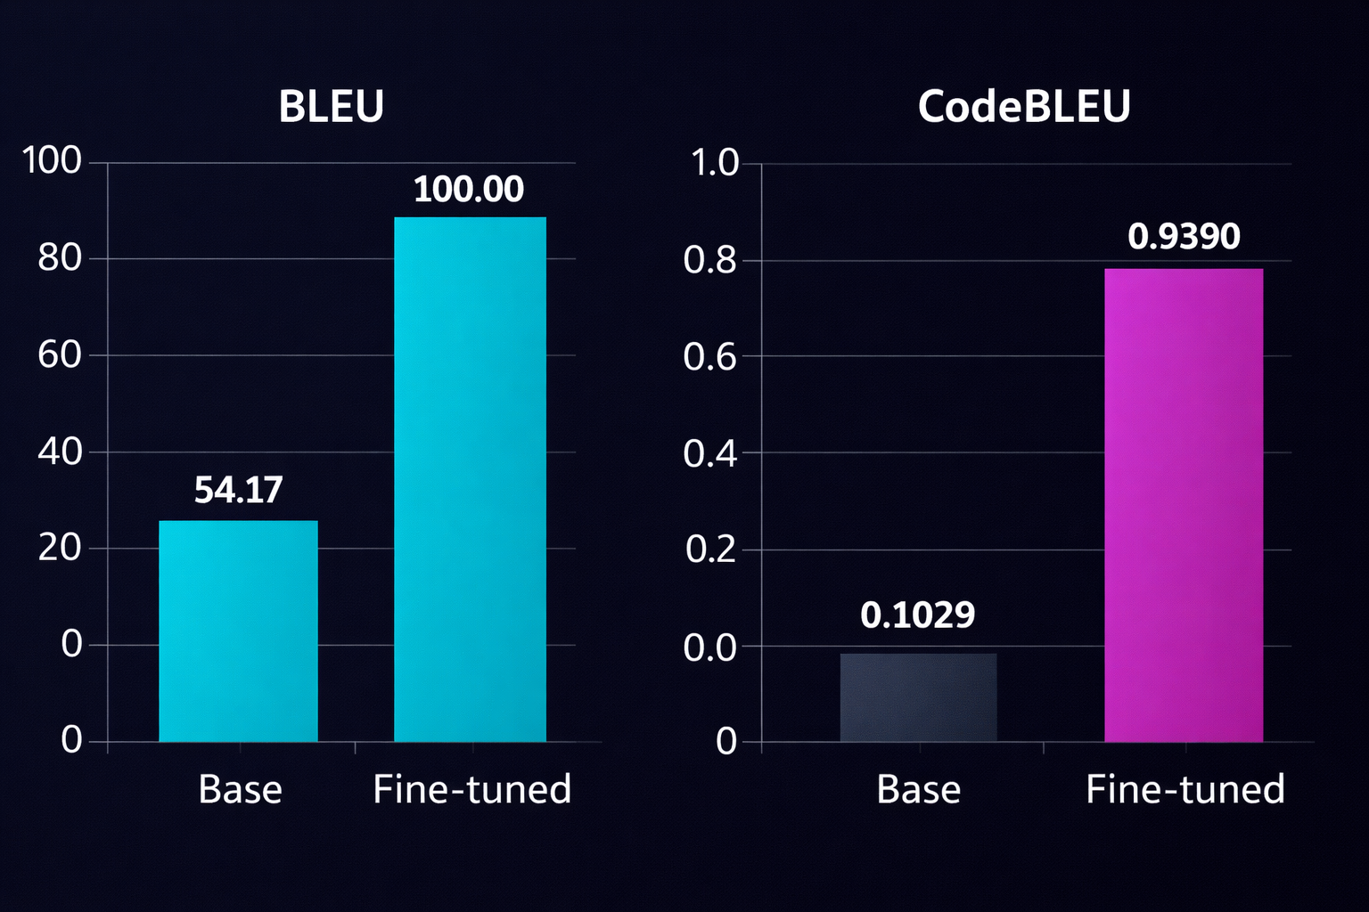
TASK 1 RESULTS: NEAR PERFECT TRANSLATION
PERFORMANCE LEAP
The fine-tuned model achieved state-of-the-art results, showing massive improvements over the base model.
>
BLEU Score: Measures surface-level textual similarity.
>
CodeBLEU: Measures semantic and syntactic logic (AST + DataFlow).
>
Functional Correctness: 72.06% of translated code ran successfully.
Task 1: Results

Slide 6
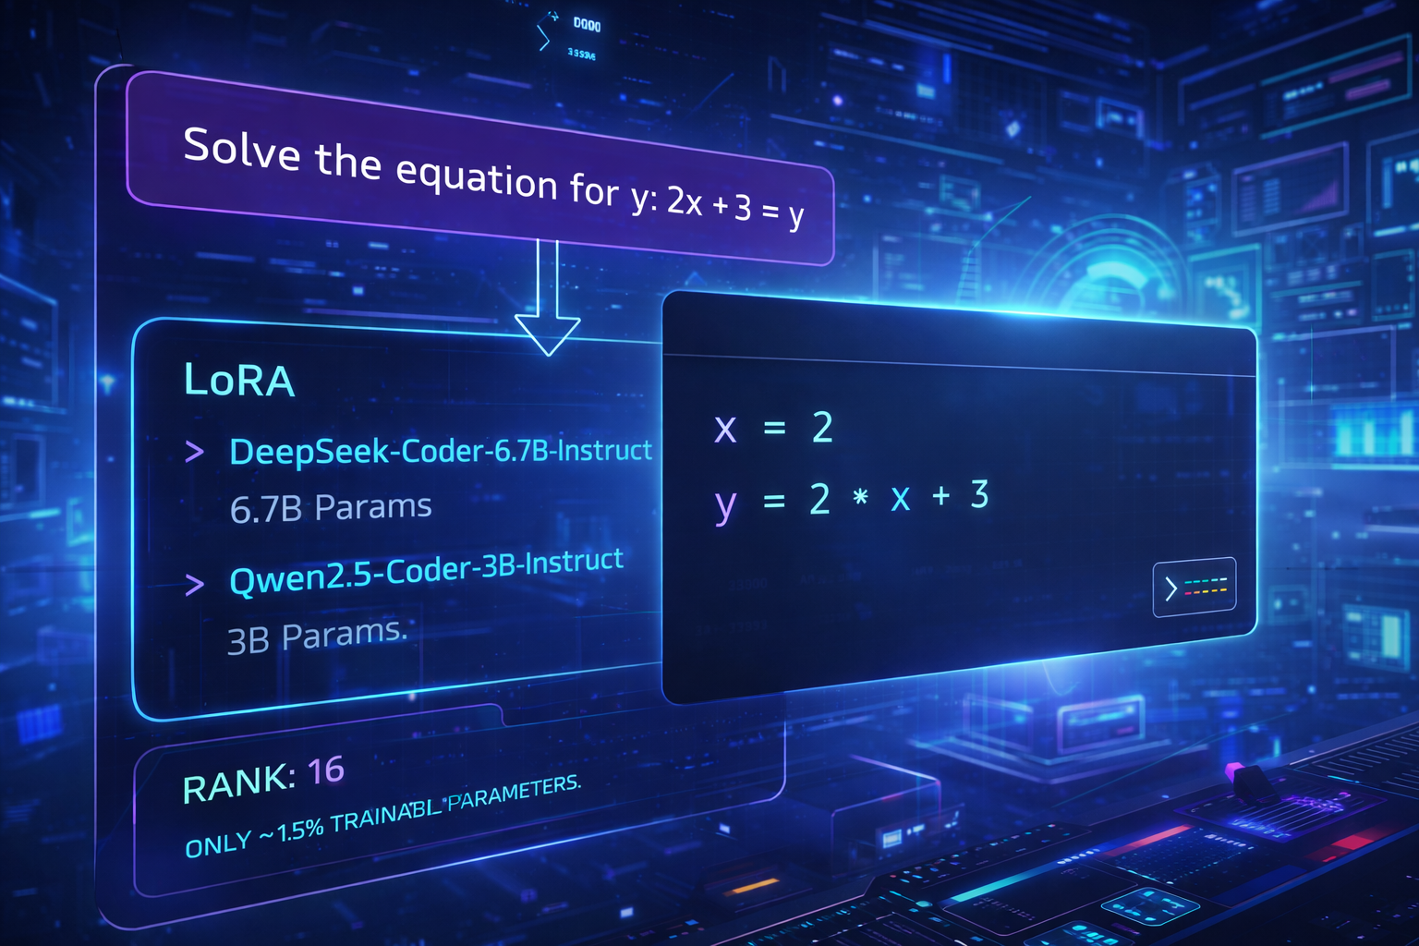


TASK 2: CODE GENERATION WITH LORA
OBJECTIVE: TEXT TO PYTHON
Synthesizing Python solutions from algorithmic problem descriptions using parameter-efficient fine-tuning.
The Models
>
DeepSeek-Coder-6.7B-Instruct: 6.7B Params (Quantized to 4-bit).
>
Qwen2.5-Coder-3B-Instruct: 3B Params.
LoRA Config
Rank (r) = 16, Alpha = 32. Targeting all Linear layers. Only ~1.5% trainable parameters.
Task 2: Generation Setup

Slide 7


THE DATA CHALLENGE
INITIAL FAILURE: MBPP + TACO
Using standard competitive programming datasets led to a "Loss Explosion." The models failed to converge due to excessive I/O boilerplate and messy formats.
THE SOLUTION: SYNTHETIC DATA
We generated a pristine dataset using Gemini 3 Pro and Claude Opus 4.5 thinking.
>
1,600 High-quality Training Samples.
>
Clean function signatures (No I/O noise).
>
Stable convergence achieved.

Slide 8
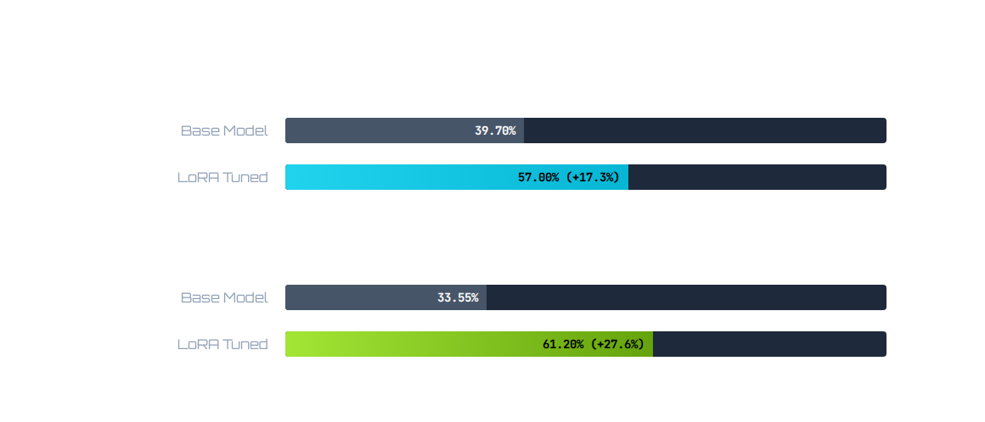
TASK 2 RESULTS: PASS@1 IMPROVEMENTS
LoRA fine-tuning yielded significant gains in the "Pass@1" metric (probability of the first generated code executing correctly).
Insight: The smaller Qwen model benefited MORE from fine-tuning than the larger model.
Task 2: Quantitative Results

Slide 9
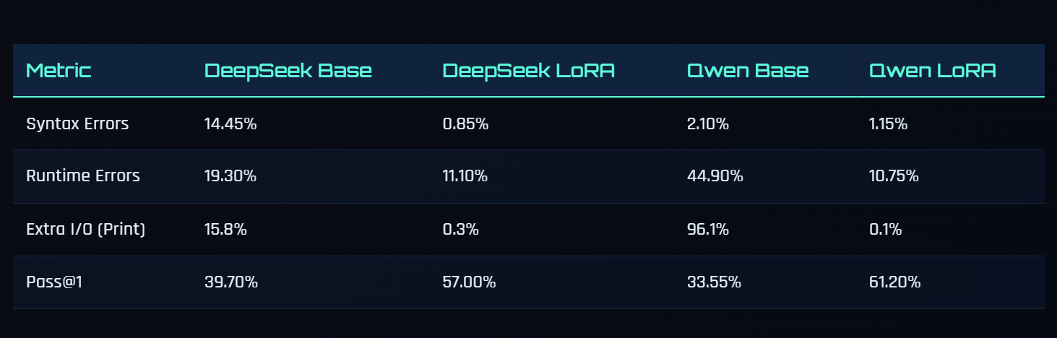
ERROR ANALYSIS: QWEN MODEL
LoRA fine-tuning drastically changed the failure patterns, nearly eliminating compilation and runtime errors.
Error Type | Base Model | LoRA Fine-tuned | Change
SyntaxError (Code doesn't compile) | 2.10% | 1.15% | Improved
RuntimeError (Crashes during run) | 44.90% | 10.75% | -76% Reduction
AssertionError (Wrong Answer) | 19.40% | 26.85% | Increased
Extra I/O Rate (Bad Formatting) | 96.1% | 0.1% | Eliminated
Note: The increase in AssertionErrors suggests the model learned to write valid code (runs without crashing) but sometimes produces incorrect logic.
Task 2: Error Analysis

Slide 10
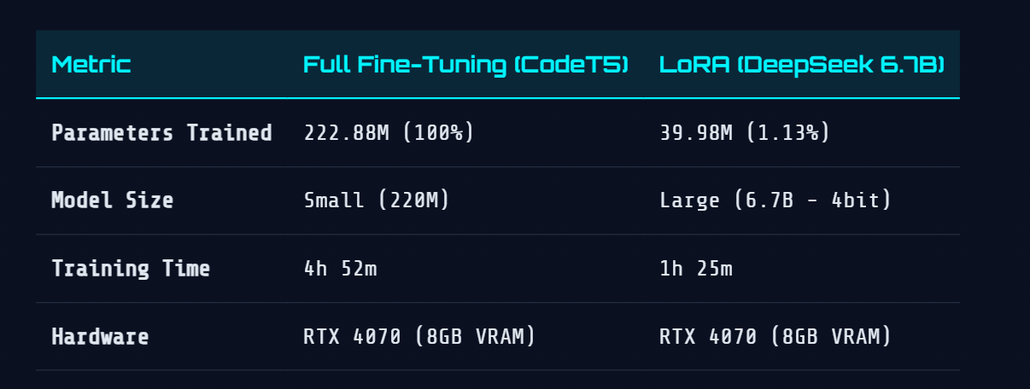
EFFICIENCY: FULL FT VS. LORA
RESOURCE CONSUMPTION
LoRA enables training massive models on standard laptop hardware (RTX 4070, 8GB VRAM) via 4-bit quantization.
Efficiency Analysis

Slide 11






KEY TAKEAWAYS
FULL FINE-TUNING
LORA EFFICIENCY
SMALL VS LARGE
Remains the gold standard for specialized translation tasks on smaller models (CodeT5).
Democratizes access. Enables 7B+ parameter model training on consumer laptops with excellent results.
Smaller models (Qwen 3B) show greater relative elasticity and improvement from LoRA than larger counterparts.

Slide 12
Q & A
Thank you for your attention.
Shujun Liao & Vipin Chaudhry

